Slide 1
How To Transform Our Culture For Church Growth
Dr. Paul Kim
Asian-American Relations Consultant
Executive Committee, SBC

Slide 2
Overview
Know our community
Know our people in the church
Know our culture in our people
Know God's strategy
Know God's power

Slide 3
Know Our Community
Engage in our local government
Contact our business owners
Involve in school activities
Reaching out to social services
Work with religious organizations

Slide 4
Overview
Know our community
Know our people in the church
Know our culture in our people
Know God's strategy
Know God's power

Slide 5
Know Our People In The Church
Love our church family members, esp. children and youth
Show our concerns of their workplaces
Pray for their needs to be met
Help their spiritual growth
Encourage their talents for leadership development

Slide 6
Overview
Know our community
Know our people in the church
Know our culture in our people
Know God's strategy
Know God's power

Slide 7
Know Our Culture In Our People
Talk to our children for their school
Listen to our youth's inner cries & struggles for their dreams
Spend time with college students to learn their stress, relationships, future directions...
Help singles for jobs & marriage in biblical counseling
Encourage married couples in their family life, esp., their children, jobs, aging parents...
Provide needs of our seniors & their life in retirement

Slide 8
Overview
Know our community
Know our people in the church
Know our culture in our people
Know God's strategy
Know God's power

Slide 9
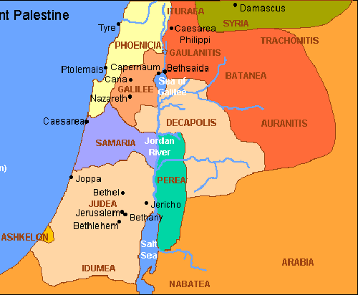
Know God’s Strategy
Study the biblical worldview how to transform our culture and community
Implement God's wisdom in the biblical time to transform our 21st century issues
Examine the biblical principles how the Jerusalem Church grew in the Book of Acts
Learn what God's strategy was in life of Apostle Paul to transform the Roman Empire
Believe that God is at work to transform our ministries through His church

Slide 10
Overview
Know our community
Know our people in the church
Know our culture in our people
Know God's strategy
Know God's power

Slide 11
Know God’s Power
Ask for God's unlimited power to work through God's people for church growth
Experience God in our daily walk of life from God's point of view
Share our faith to lead lost people to know Christ as one's personal Lord & Savior
Participate in our local church's ministries to impact our community
Be obedient to the Great Commission through our local church to build stronger cooperation in SBC to transform our generation

Slide 12
Questions and Answers
Webpage: asianbaptists.org
Dr. Paul Kim Asian-American Relations Consultant Executive Committee, SBC
E-mail: pkim@sbc.net 617-877-1930 (M)

